Slide 1
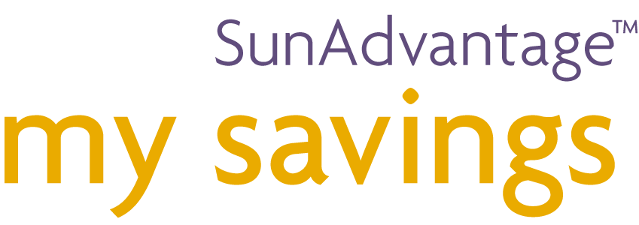
Your group plan at work
A cost effective retention plan for your employees.
Notes:
Thanks again for taking the time to talk a bit about my savings – your group plan at work.
I’m going to take you through the key features and benefits, but if you have any questions along the way, please feel free to interrupt me at any time.

Slide 2
Agenda
Why a Group Savings Plan
Why Sun Life Financial
Introduction to ‘my savings’
Value to Plan Sponsor/Plan Member
RRSP vs TFSA vs DPSP
Funds
Investment Options
Wrap-up

Slide 3

Your team is your competitive advantage

Slide 4
Why offer a group savings plan?
Everyone has a dream
  A savings plan provides the means
Employee attraction and retention tool
  Shows concern for employees’ future
No cost to sponsor
  Contribute at their convenience
Notes:
Before I give an overview of this particular plan, I want to highlight the benefits of offering an employee savings plan in general -- for both you and your employees.
First, it provides an easy way for employees to save for retirement and other goals. Everyone has to save for their future, and the automatic contributions that an employee sets up in advance ensures they can pay themselves first – and often they don’t even miss the money they’re setting aside.
Second, it’s a perk or benefit that’s in addition to their regular pay-cheque, so it carries a highly perceived value. It can help you attract new employees – especially those that are coming from an employer that already has a plan – and retain employees as well, since it’s an additional feature that they will come to rely on over time.
Third, it sends a message that you’re looking out for the future of your employees and that your relationship extends beyond just pay for work. This benefit is often overlooked, but it can make a difference in terms of helping the employer/employee relationship.
And, these are plans you can set up at absolutely no cost to you. And of course, as an employee yourself, you can also take full advantage of the lower investment management fees and convenience of the Plan as well.
Lastly, keep in mind that a DPSP allows you to reward your employees for their role in the financial success of your business. DPSP contributions are made “out of business” profits and are not made when profits are negligible. Your contributions are not considered to be a taxable benefit to employees and therefore are not subject to payroll deductions at the source. Offering an RRSP provides employees with systematic retirement savings and an immediate reduction of taxes to employees. This is an important benefit – it gives you another compensation option, aside from salary increases, to offer your employees.
NOTE: Contributions to the TFSA are made by the member directly by setting up an automatic chequing plan from their bank account. Employers will appreciate not having to remit member contributions to the TFSA since it will simplify the employer’s payroll deductions since they do not need to deduct both before tax (RRSP) and after tax (TFSA) amounts.

Slide 5
Why Sun Life Financial?
1st in group retirement services
Organizational principles driving our business:
  People
  Partnership
  Passion
  Performance
Notes:
PEOPLE
Treat people with dignity and respect
Be present to people
Acknowledge and reward contributions
Build capability through learning
PARTNERSHIP
Be a team player
Communicate clearly and honestly
Request and offer feedback
Create win-win situations
PASSION
Be enthusiastic and energetic
Demonstrate a ‘can do’ attitude
Be creative
Strive for wholeness
PERFORMANCE
Take ownership
Focus on customers
Practice innovation
Act with speed and urgency

Slide 6

Experience means understanding
Notes:
We understand what plan sponsors and their plan members need.
We have the largest transaction database to help us understand what works, where, and why.

Slide 7
Why my savings?
No-cost, no-hassle administration – designed specifically for small businesses
Allows saving for any goal – with RRSP, DPSP and TFSA
Two combinations of savings products available:
  Option 1: RRSP, DPSP and TFSA or
  Option 2: RRSP and TFSA
Exceptional range of pre-selected investment options
Often lower than comparable retail fund management fees
One on one plan advisor support
Notes:
I’ll go into each feature in a bit of detail in the slides that follow, but here’s a quick overview of why this plan can be a great addition to your company’s programs.
Time is money, and in addition to the zero cost to you in terms of fees, we’ve also designed the plan to be a no-hassle administration experience, with very little time required on your part.
Three ways to save – RRSP, DPSP and TFSA – allows employees to save for any savings goal, long term or short term.
Employees have access to a full range of investments from top managers, including several exclusive funds only available to Sun Life Financial group plan members.
Employees will save money on fees – a group Plan provides economies of scale when it comes to fund management fees.
You will have access to ‘ME’ (Plan Advisor) for any further information you may require!

Slide 8
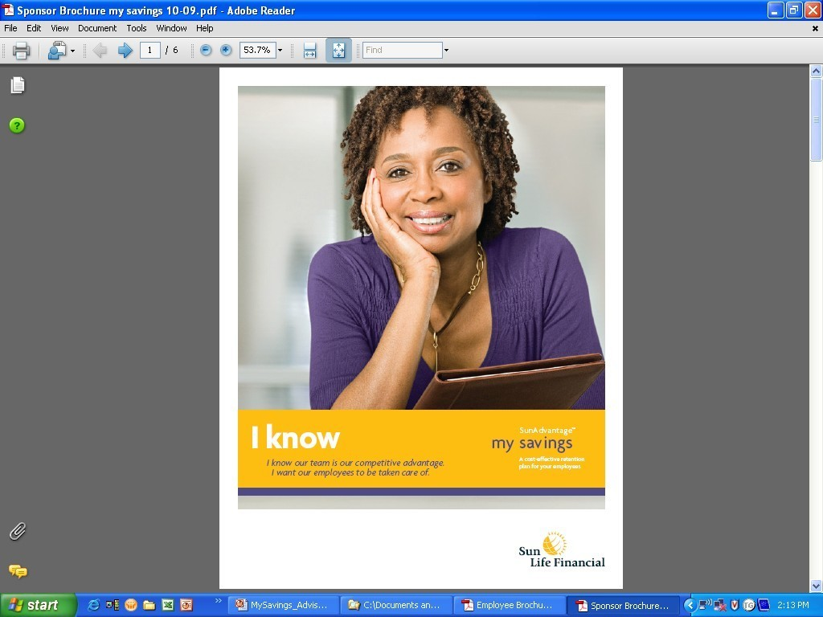
Value to the plan sponsor
Your advisor encourages employees to participate in the plan through education sessions
You remit payroll contributions – we take care of the rest
Ongoing support for members too:
  Customer Care Centre
  Plan member services website
Notes:
Sun Life Financial takes care of almost all of the day-to-day administration details for your plan. We create and maintain account and investment records, process transactions, mail annual statements and tax forms, do Canada Revenue Agency reporting, and much more.
Your role is ensuring that employees have a basic understanding of the plan, encouraging them to participate, then remitting the payroll contributions each pay period – something that can easily be done online in just a few minute’s time.
Your employees also benefit from extensive administrative support – through the Customer Care Centre and Plan Member Services website, plus access to me or other professional representatives every business day if they need the personal touch in handling questions or transactions.
And if you ever have questions or need additional support in the administration of your Plan, please call me.

Slide 9
Sponsor services
Implementation time
Contribution method
Plan sponsor statements and reports
Administration
Notes:
Time to implement a plan:
Plan set-up within 2 weeks of receipt of completed application
No waiting, plans will be set up quickly so that sponsors can begin sending contributions as soon as they’re ready.
Contribution Method:
Submission via secure website
Payment via pre-authorized withdrawal for RRSP and DPSP
TFSA contributions are member contributions only (automatically deducted from bank account)
To ensure quick deposits and to manage a cost effective solution, all contributions are submitted electronically.
Plan sponsor statements and reports:
Monthly online financial and non-financial reports
Access to our sponsor website 24/7
Access to Morningstar for information on investments
The plan sponsor services website allows sponsors to submit contributions, run reports and find plan information at any time.
Administration:
Access to dedicated Client Services Team
Access to data regarding employee contributions
Sponsors will receive high quality support from the industry leader for group savings plans.

Slide 10

Value to the plan member
24/7 access to member’s account:
  By phone, 1-866-733-8613
  Interactive website, www.mysunlife.ca
    Get fund balances
    Move money between funds
    View tax slips and receipts
    Change investment instructions
    Get detailed fund information
    Update their beneficiary
    Use one of the many online financial planning tools
    And much more…
Notes:
In terms of support in managing their accounts, the Plan Member Services website is always open for employees, with 24-hour a day access. They can also access account information by touch-tone phone or talk directly to a Group Retirement Services representative through the Sun Life Financial Customer Care Centre any business day from 8 a.m. to 8 p.m. ET. Fees may be charged for certain transactions.

Slide 11
Member services
Express member enrolment
Welcome to my savings!
Member statements
24/7 Access
Notes:
Enrolment:
Our product has a simplified enrolment process called “express enrolment,” which makes it easier for members to enrol. Members aren't asked to provide investment instructions as part of the enrolment process. They are asked to provide the minimum personal information needed to set up their account allowing them to be quickly enrolled in the plan. Initially, member contributions are defaulted to temporary default investment options. The default fund for the RRSP and DPSP is the Sun Life Financial Granite Target Date Segregated Fund with the maturity date occurring just prior to the member's 65th birthday. The default fund for the TFSA is the Sun Life Financial Bond Index Segregated Fund.
These are only temporary investments at enrolment, and members are encouraged to assess different investment options based on their risk profile.
Welcome:
Once the member has enrolled, they will receive their welcome letter which will include the information that they need to register for member website access. With access to the member website, the member can go online and use our retirement planning tools and investment risk profile questionnaire, get detailed information about the investment options available to them, and make changes to their investment instructions at a time convenient for them. Having members go online to use our retirement planning tools and access investment information reduces the amount of paper that members receive at the time of enrolment; it also ensures that members always receive the most up to date investment information.
Statements/Reports:
Member statements will be mailed to the member’s home once a year in December. Members have access to their balances throughout the year on our member website and a second statement will be available online each June. Members can also choose “paperless statements” by providing their consent on mysunlife.ca. Members will receive email alerts when statements are available online.
Administration:
Member’s have 24/7 access to their account:
• Interactive website, www.mysunlife.ca
• By phone 1-866-733-8613 to our world class call centre:
> Speak directly to a representative from 8:00 a.m. to 8:00 p.m. ET
> Or use the automated phone system 24/7

Slide 12
Features of three accounts
Group RRSP | DPSP | TFSA
Tax-deductible savings Tax-sheltered earnings Contribute up to RRSP limit Withdrawals are subject to withholding tax Ideal for retirement savings | Sponsor shares profits by contributing to DPSP on behalf of each employee* No minimum employer contribution required Tax-deductible savings for sponsor Tax-sheltered earnings Contribute up to DPSP limit Withdrawals are subject to withholding tax Ideal for retirement savings * Based on eligibility | No tax-deductibility, but tax sheltering Contribute up to TFSA limit Tax-free withdrawals and can “re-contribute” amount withdrawn Withdrawals increase contribution room in the following calendar year Ideal for any savings goal
Notes:
my savings provides a Group RRSP account, a DPSP and a TFSA option. Combined, these accounts are highly effective ways for your employees to save for both long and short-term goals.
The Group RRSP offers the benefit of pre-tax payroll deduction contributions, so employees get an immediate tax break every time they contribute. They can contribute up to their RRSP limit each year. With earnings and contributions fully tax-sheltered until withdrawn, this is an ideal way to save for retirement.
The DPSP rewards employees for their role in the financial success of the business. As the employer, you can share business profits with employees by contributing to the DPSP on each employee’s behalf. Contributions can vary year to year depending on company results. Significant shareholders or family members* are not eligible to enrol in a DPSP. These members are eligible to enrol in the RRSP and TFSA and you can make contributions to the RRSP instead of the DPSP for these members. Members cannot contribute to DPSPs. DPSPs are subject to maximum contribution limits set by CRA.
The Group TFSA doesn’t provide a tax deduction up front, but it does provide a multi-purpose savings vehicle in which all investment earnings are tax-sheltered. Since TFSA withdrawals are tax free, members can re-contribute in a subsequent year, any amount they withdraw, without penalty – it can be an ideal way to save for any goal. The first withdrawal from a plan member's TFSA in each calendar year is free. A $25 fee will apply for any additional withdrawals during the year.
The straightforward nature of these products makes it easy for your employees to understand the value that these savings accounts can provide and they are hassle-free for you.
* For more details, please see DPSP Eligibility in section 6 of the Application form.

Slide 13
RRSP and DPSP Features
 | RRSP | DPSP
What offer it? | Simple administration for employers Easy for employees to understand | Rewards employees for their role in the financial success of the business Contributions can vary year to year depending on company results
Tax implications | Employer contributions are a taxable benefit to employees Employer contributions are subject to payroll tax | Employer contributions are not considered a taxable benefit to employees and therefore not subject to payroll deductions at source
Eligibility | Employer’s choice | Employer’s choice, although their partners, specified shareholders and their immediate relations are not eligible

Slide 14
RRSP and DPSP Features
 | RRSP | DPSP
Employer contributions | Optional but recommended No minimum Combination of employee an employer contributions must not exceed the CRA contribution limit | Must be made from company profits (current or accumulated) Plan may require a minimum but contributions are not allowed if the business has no profit Contributions must not exceed CRA contribution limit
Employee contributions | Optional but recommended | Not permitted
Contribution limits | Total contributions depend on a member’s available contribution room. A member’s contribution room is increased annually by the lesser of 18% of their previous year’s earnings or the contribution limit specified by CRA for the year | Total contributions must be the lesser of 18% of current year’s earnings or the contribution limited specified by CRA for the year

Slide 15
RRSP and DPSP Features
 | RRSP | DPSP
Vesting | Immediate | As per plan rules. No later than two years after member enrols
Plan documentation and reporting | Registered as specimen plan with CRA Government reporting by employer only when employer contributions are made Employer contributions to be shown as a taxable benefit on the member’s T4 slip | PA reporting on member’s T4 slips T3D trust return prepared by Sun Life
Member reporting | T4RSP slip for withdrawals RRSP receipts for employer and employee contributions | T4A slip for withdrawals T10 slip for Pension Adjust Reversal (PAR)

Slide 16
Low fees
Bulk buying with group plans allows for economies of scale for fund management fees
Fees are often lower than comparable retail options
Savings can really add up over time
Notes:
A key advantage of this plan is the fees that employees will save when they invest through their group plan rather than through regular retail channels.
With a set investment lineup and group plan buying power, fund management fees are often lower than those for comparable retail funds.
And while the percentage difference may seem small, let me show you what kind of a difference this can make over time…

Slide 17
Low fees
Growth of $50,000 at 5.75%
1.70% Management Fee
2.20% Management Fee
Notes:
In this example, an employee has $50,000 in savings and earns an average annual investment return of 5.75%.
While the difference in fund management fees may seem small, 1.70% versus 2.20%, although the difference is less than 1%, the savings can really add up over time.
In this example, the employee would save an additional $15,000 over a 25 year career, just by investing through the plan rather than through comparable retail funds. So the benefits to employees are quite tangible in terms of being able to save money over time.

Slide 18
Wide range of investment options
Top investment managers
Many funds available exclusively through Sun Life Financial group plans
Series of pre-built portfolios OR build your own portfolio option
Notes:
In terms of employees investing their savings, they have a wide choice of investment categories to choose from.
These include a number of “pre-built” portfolio options – in which the employee chooses a single portfolio that’s designed to be a one-stop investment solution. For example, the Granite Target Risk Funds hold a diversified mix of stocks, bonds and cash, with funds ranging from conservative to aggressive.
Your employees also have access to lifecycle or target date funds that are structured to coincide with a key life event such as retirement and have a portfolio asset mix that adjusts automatically as you get closer to your goal. Both the SLF Milestone Funds and SLF Granite Target Date Funds are available to them under the Plan.
In addition, if employees prefer to build their own portfolio, they can choose from a mix of 14 segregated funds and 5 guaranteed funds to create their own diversified portfolio to match their investor profile.
The funds offered by SunAdvantage my savings are segregated funds. Segregated funds are funds which are held by an insurance company separate from the insurance company’s assets. Unlike retail segregated funds, funds under a group arrangement do not provide a death or maturity guarantee. The Milestone funds offer a guaranteed unit value at maturity based on a set maturity date that applies to all unit holders in the fund.

Slide 19
Wide range of investment options
Choose your own portfolio from the following asset categories:
“Pre-built portfolio solutions”
GDIA
Guaranteed Funds
(1, 2, 3, 4,5 year)
Fixed Income
Balanced
Canadian Equity
U.S. Equity
International Equity
Global Equity
Milestone Funds
Granite Target Date Funds
Granite Target Risk Funds

Slide 20

Granite Funds™ – Target Date
When does the member need the money?
Pre-built solutions – with an asset mix that changes over the life of the fund
Multi-manager solution
Fees
Managers were selected who have:
  Superior long term performance
  Expertise in their asset classes or investment styles
Notes:
Similar to the Milestone Funds, the member will simply select the date that coordinates with the date they plan to retire. The Granite Target Date segregated funds are designed with having the goal of outperforming their benchmarks over a four year period. A mix of analysis was then used to select managers who:
Have demonstrated superior performance over the long-term
Have proven expertise in their asset class or investment style
The funds focus on a target retirement or maturity date with an asset mix that changes throughout the life of the funds – automatically. As the fund draws closer to maturity (the date of the fund), the asset allocation evolves. Typically, this means that the higher risk investments, such as equities, will decrease and the lower risk investments, such as fixed income, will increase over the life of the funds.
The investment management fees are lower on Granite Target Date funds than those included in the Milestone funds. However, the Granite funds do not include the guarantee that applies to the Milestone funds.

Slide 21
Milestone Funds® – Target Date
Sun Life Financial Milestone Segregated Funds
Target date funds
All you have to do is choose the Fund that is closest to the date you’d like your money, and it takes it from there
Maturity dates of June 30th
Notes:
The Sun Life Financial Milestone Funds combine defined maturity, unique guarantees and a dynamic asset mix to deliver simplified investing for plan members.
A plan member simply needs to answer… “When do you plan to retire?” or “When do you want to start using your investment?”

Slide 22

Milestone Funds® - Features
Worry-free - the guarantee provides a safety net during down markets.
Easy - each fund automatically rebalances as its maturity date draws closer.
Rewarding – The member can buy when the market value is low and immediately benefit from a higher historical guaranteed maturity value.
Notes:
Advantages:
Encourages plan members to invest when the market value is low because they will automatically be entitled to any higher month-end market value
Discourages members from redeeming at a low unit value as they will lose the guaranteed maturity value if they do
Simplifies communication and education initiatives
Asset mix of the Fund is automatically adjusted as it approaches maturity
100% RRSP, DPSP and TFSA eligible
Valued daily and fully liquid like our other segregated funds

Slide 23
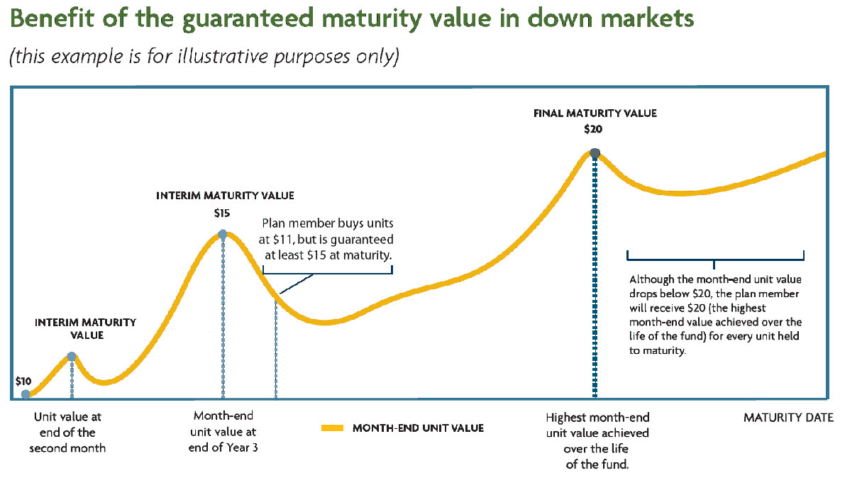
Milestone guarantee
Notes:
FOR EXAMPLE:
Let’s say you have $40,000 to invest and you choose the Sun Life Financial 2040 Milestone Fund.
The market value of this fund is $11/unit, while the guaranteed maturity value is $15/unit. If you stay in the fund until it matures, you gain at least $4/unit.
Jump ahead to the year 2030. The guaranteed maturity value rises to $20/unit and stays there even though the market value drops a year later to $17/unit.
Let’s do the math:
The original purchase price you paid was $11 per unit. In 2030, the fund’s market value reaches $20 per unit, which ultimately becomes the guaranteed maturity value. You are now guaranteed to receive $20 for every unit held in the Milestone Fund if you stay in the fund until it matures in 2040, a $9 gain per unit held.
The Milestone Fund may not be suitable for a TFSA unless the maturity aligns with a specific & planned use of the TFSA money – e.g. Retirement.

Slide 24

Not everybody has the same investment tolerance at the same stage of life…

Slide 25

Granite Funds™ – Target risk
Pre-built target risk funds
5 corresponding fund categories:
  Granite Conservative Segregated Fund
  Granite Moderate Segregated Fund
  Granite Balanced Segregated Fund
  Granite Growth Segregated Fund
  Granite Aggressive Segregated Fund
Notes:
We developed the Granite Target Risk Funds…
To ensure diversification across asset class, geography, investment style and currency within one fund that aligns with the risk tolerance of the member.
Each fund is automatically rebalanced each month and professionally managed to ensure it maintains it’s target asset mix
The design of the fund categories corresponds to one of the 5 risk tolerances in the SLF my money investment risk profiler.
Where should the member be investing… conservatively, balanced, aggressively?
The member will use the Asset Allocation Tool on our plan member site to find out where they fit. Or, the member can complete the Investment risk profiler which is included in the enrolment guide (it’s a brief tool/quiz to assist them in identifying their corresponding fund category).

Slide 26
Diversification
The Milestone and Granite Funds are diversified by:
  Investment Style – growth and value, active and passive fund managers
  Asset class – cash equivalents, fixed income and equities
  Geographic region – Canadian, U.S. and International equities
  Currency – limit exposure to U.S. currency risk
Notes:
No one investment style, asset class or geographic region consistently out performs year after year.

Slide 27
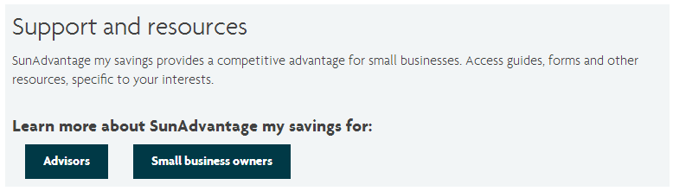
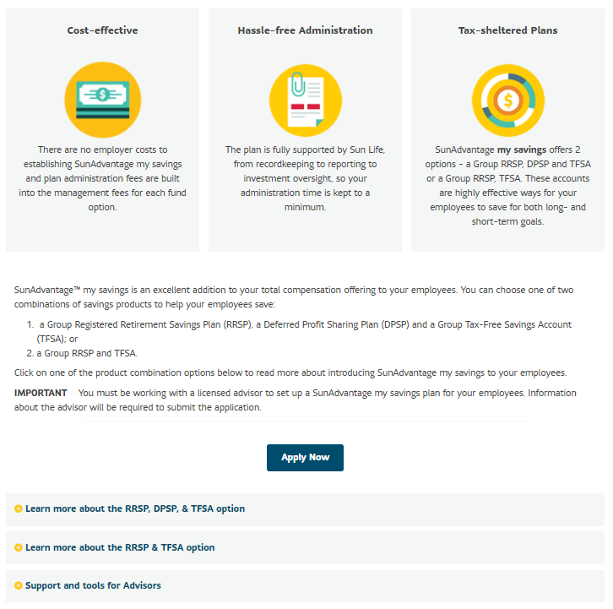
Setting up a plan
Visit the SunAdvantage microsite to access support and resources www.sunlife.ca/SunAdvantagemysavings
Plan set up documents:
  You can access contracts and applications (fillable PDFs)
Notes:
The SunAdvantage my savings microsite houses all of the materials needed to set up a plan (for Plan Sponsors).

Slide 28
Documents to set up a plan
Review the applicable contract documents on the SunAdvantage my savings microsite
Complete the following documents and submit to Sun Life
RRSP/DPSP/TFSA
Application form Resolution of the Board of Directors or Letter of undertaking (if no board of directors) T2214 CRA Application for registration as DPSP (For new DPSP registrations only) DPSP participating employer information form (For transferred DPSP only, if applicable)
Notes:
Effective date of DPSP – The effective date can be future dated but the DPSP registration will not be earlier than the date determined by the CRA, which is the registered mail postmark date.

Slide 29
Gain your competitive advantage…
Notes:
For all of the reasons I’ve just explained, my savings can provide your employees with a highly valued benefit while presenting an excellent opportunity for you to gain a competitive business advantage.
Do you have any questions about the Plan?

