Slide 1

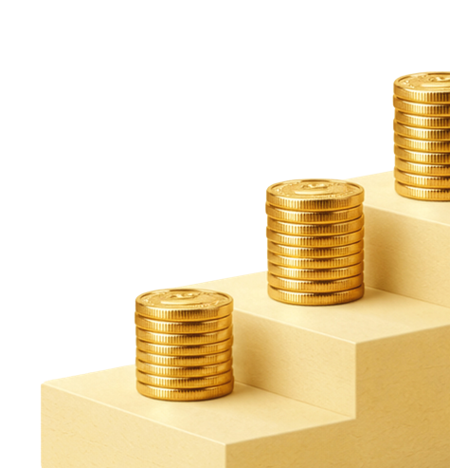
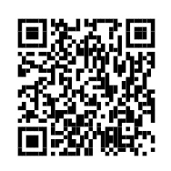
Small Steps, Big Rewards Contest
A chance to win up to $50,000
Take qualifying steps to improve your financial health using your workplace savings plan and you’ll earn entries to win:
1 of 5 $10,000 cash prizes
Or the $50,000 grand prize
Scan the QR code to learn more and earn your first entry.
Contest closes December 20, 2026.

